Slide 1

Measurement properties of physical activity devices in use in people with knee arthritis and total knee replacement: A systematic review
Ayobami E Olanrewaju
PhD Candidate
Division of Informatics, Imaging and Data Sciences
The University of Manchester
7th Feb 2025

Slide 2
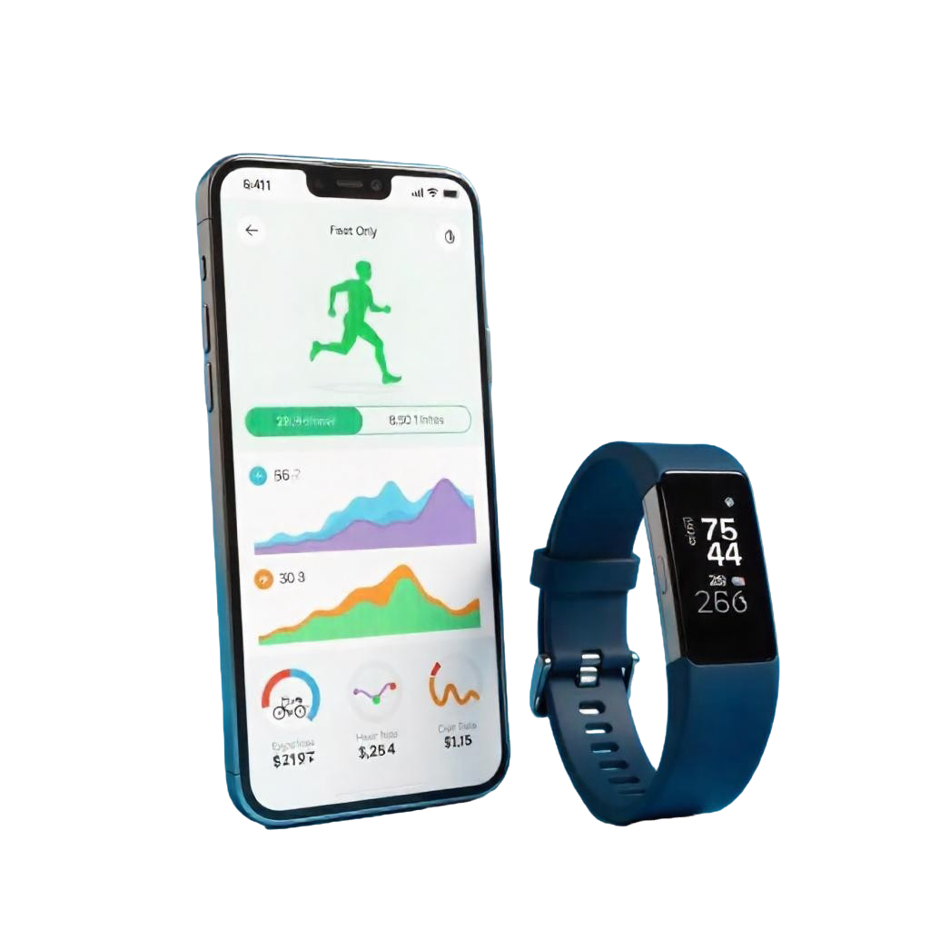
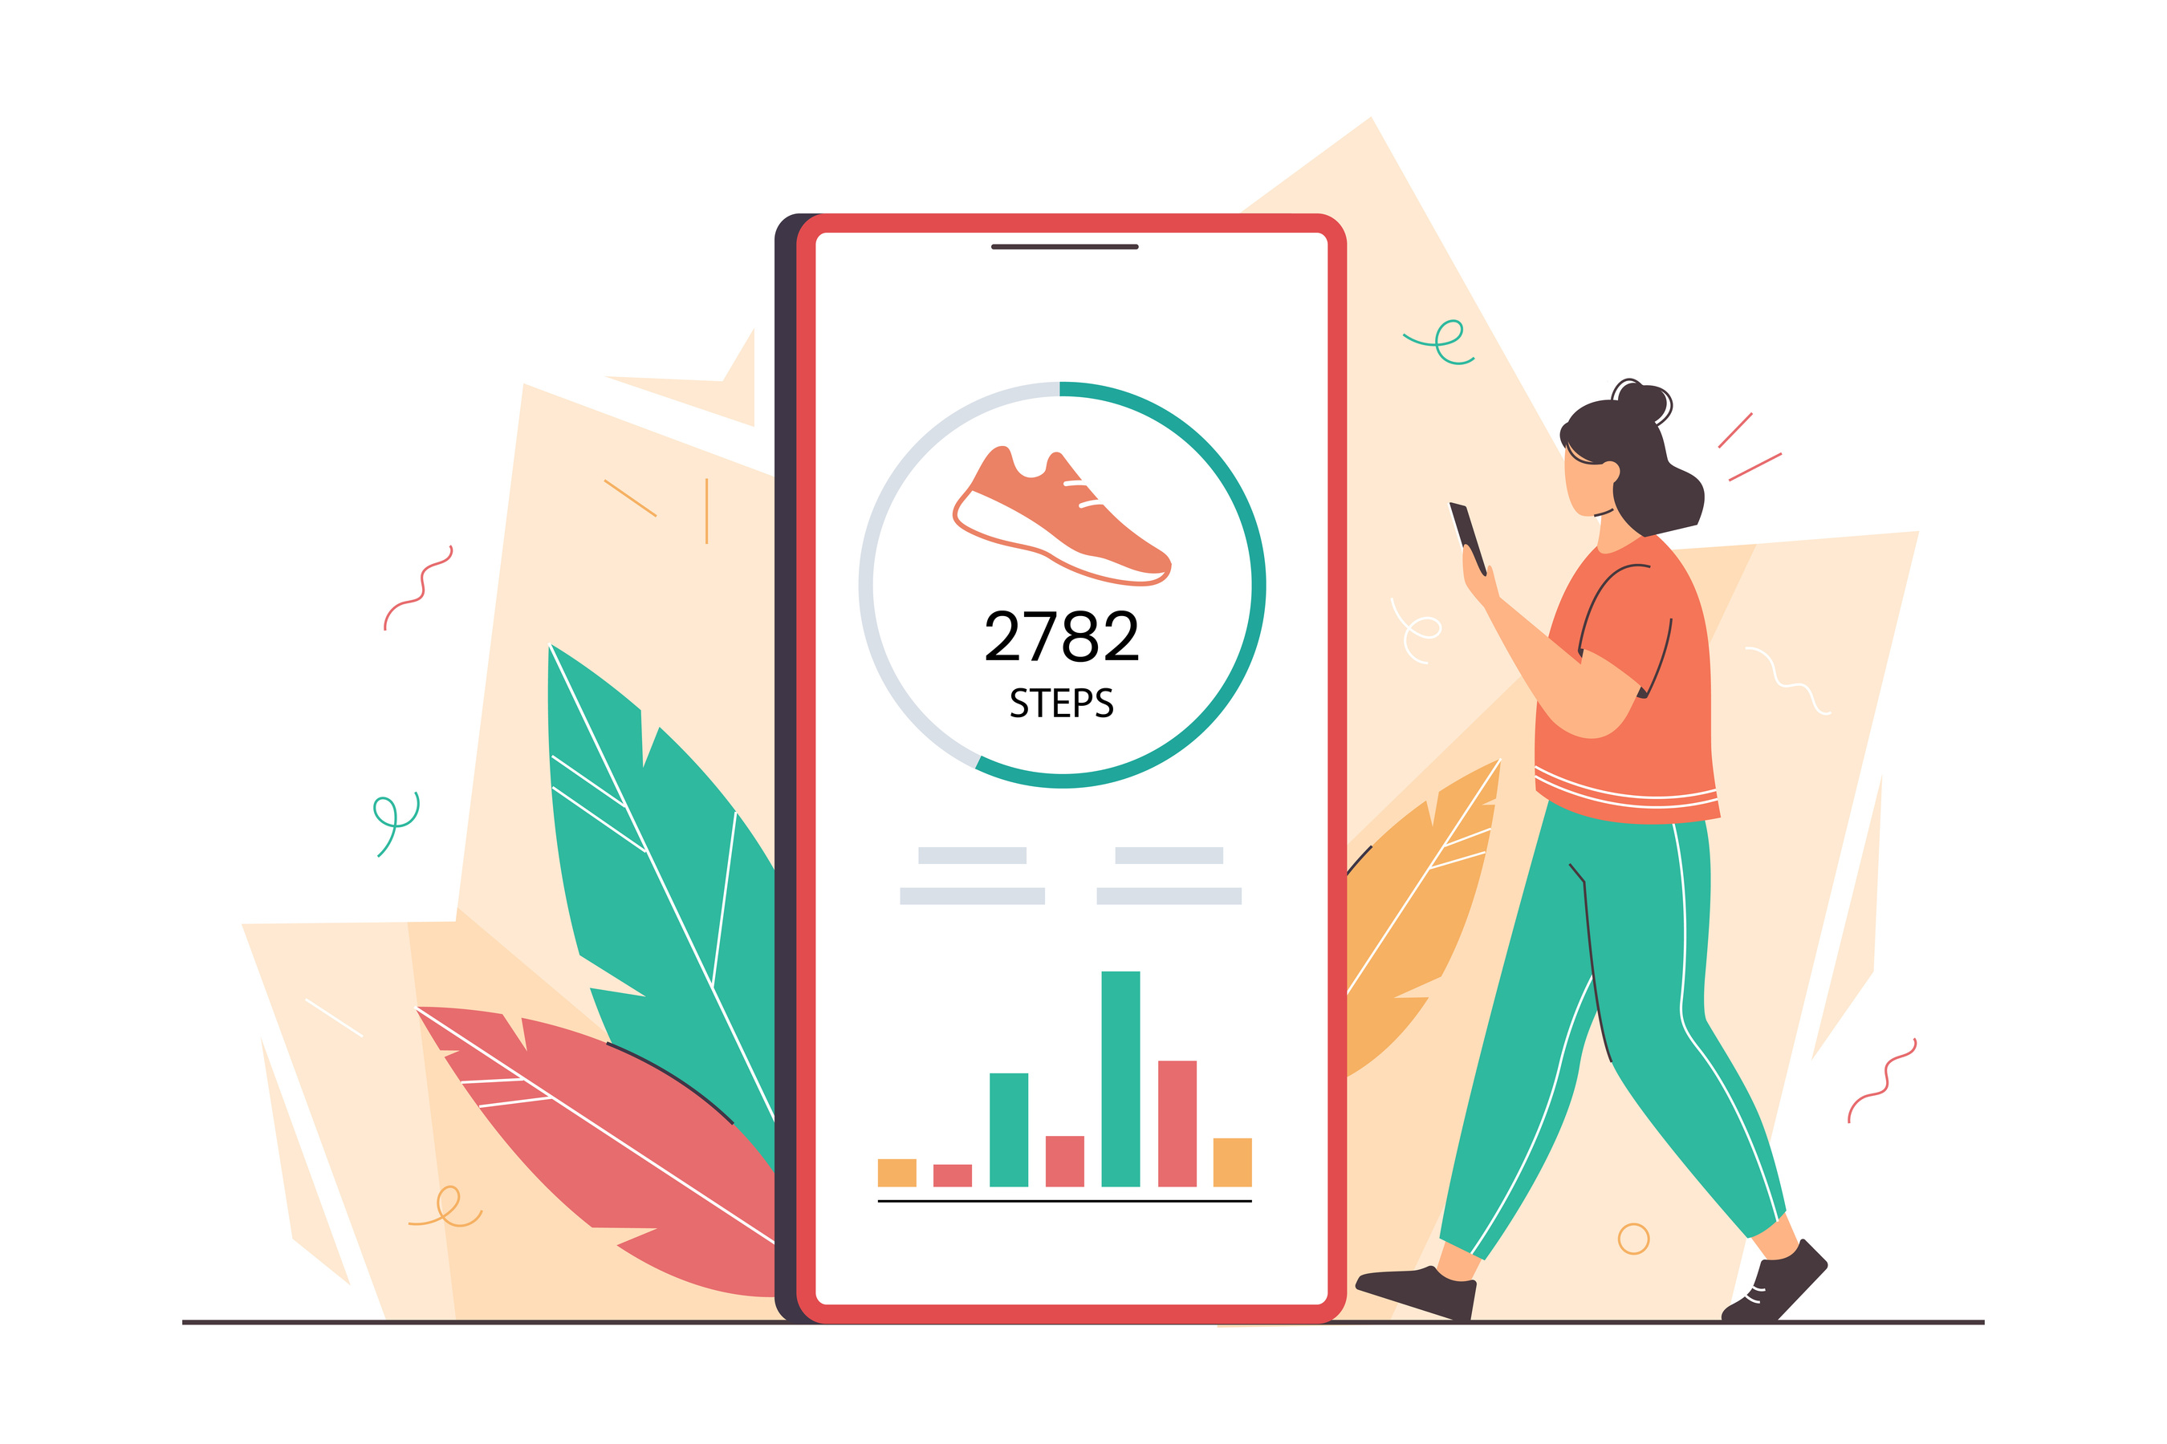

Consumer wearables allows us measure health relevant metric (e.g. physical activity)

Slide 3


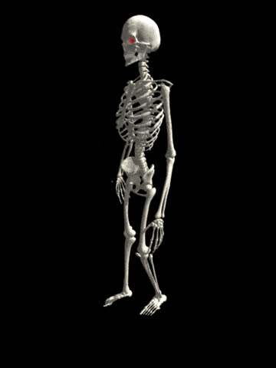
Provides opportunity to measure activity in people living with diseases (e.g. knee arthritis)
Their algorithm are often developed in normal, healthier population
Do these algorithm work in a person with knee arthritis who have different walking pattern compared to normal population?

Slide 4

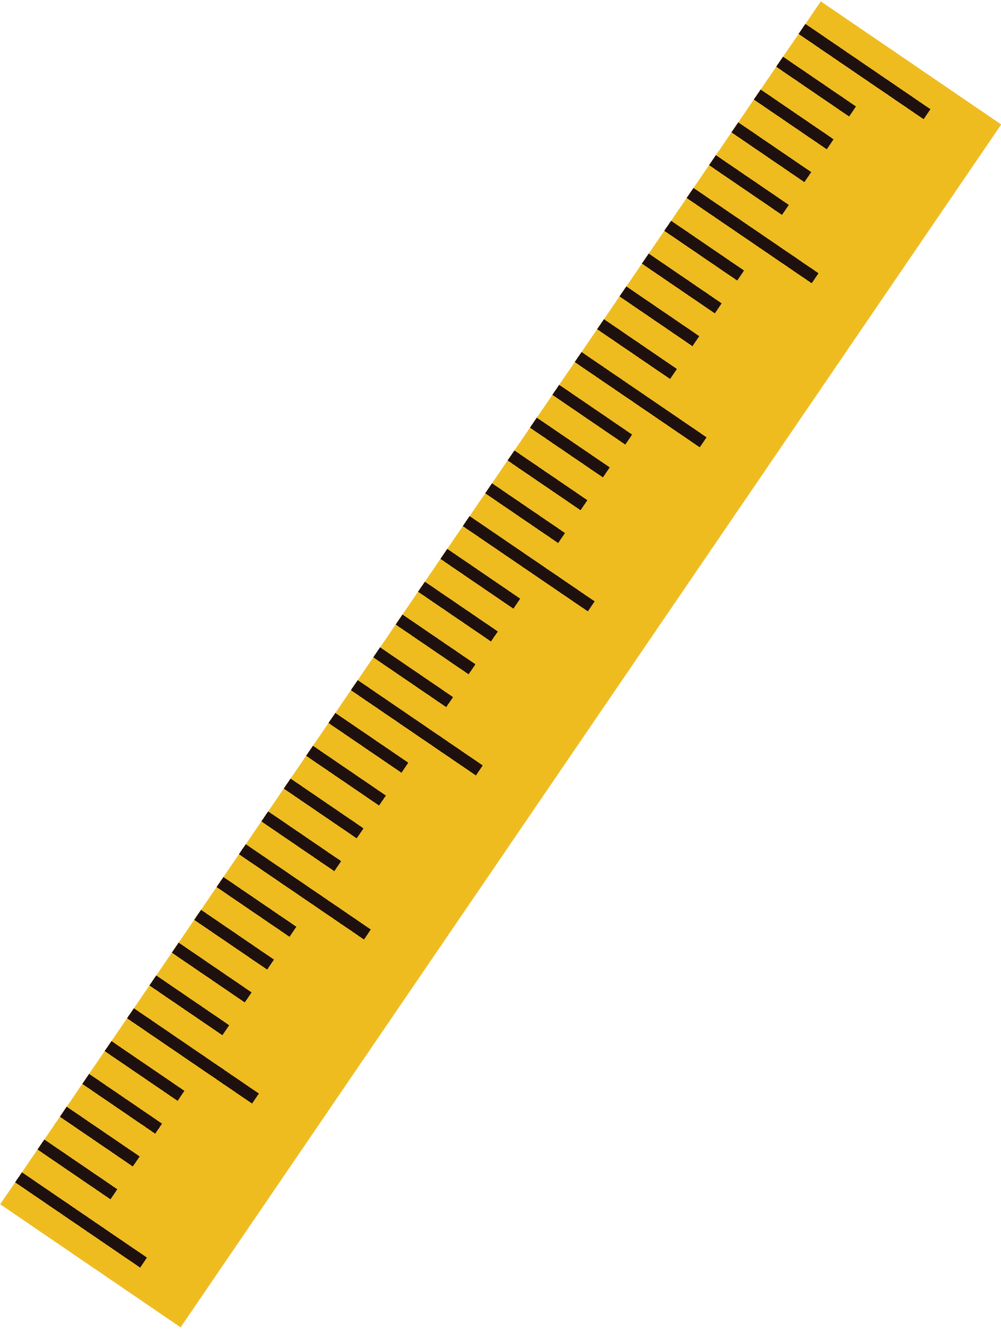

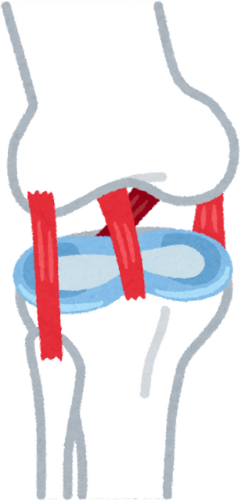

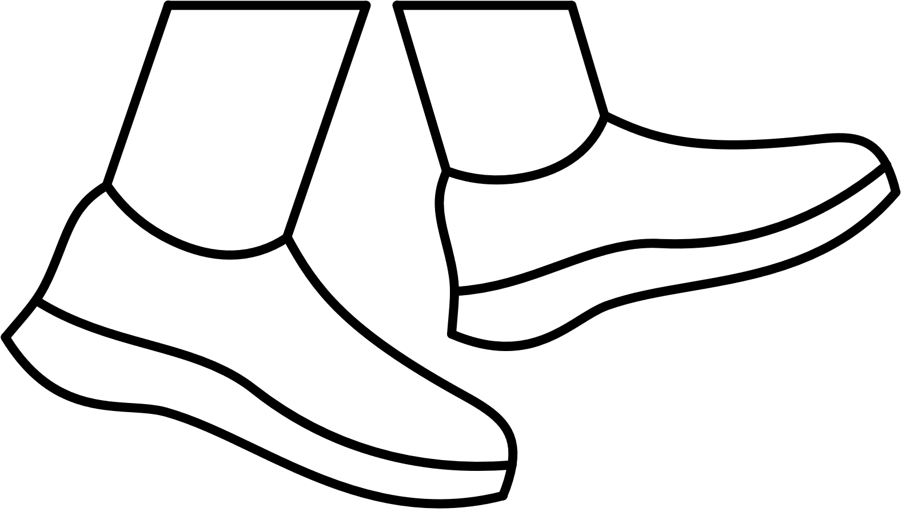

Aim
Derived metrics (e.g. step count)
Device (e.g. Fitbit, Apple)
People with knee arthritis/& total knee replacement
Systematic review
Measurement properties

Slide 5












Aim
Measurement properties
Derived metrics (e.g. step count)
Device (e.g. Fitbit, Apple)
People with knee arthritis/& knee replacement
Systematic review
Hand-search references
Database search
Removal of duplicates
Title and abstract screening
Full-text screening
Included studies
COSMIN principle guided the design, conduct, data synthesis & reporting was guided
COSMIN: COnsensus-based Standards for the selection of health Measurement INstruments
Protocol pre-registered on PROSPERO (Registration Number: CRD42024594871).

Slide 6

Rating of Measurement property results
+
-
?
(COSMIN Criteria for good)
Sufficient
Insufficient
Cannot be determined
Level of Evidence
+
+
+
+
+
+
+
+
+
+
(COSMIN’s modified GRADE)
High
Moderate
Low
Very low
High/Mod Sufficient
Low/VeryLow Sufficient
High/Mod Insufficient
Low/ very low Insufficient
Not rated /could not be determined due to lack of sufficient information
Not reported
COSMIN: COnsensus-based Standards for the selection of health Measurement INstruments

Slide 7
Study identification
1583
1575
1370
634
553
197
21
EMBASE
WEB OF SCIENCE
SCOPUS
CINAHL
MEDLINE
SPORTDISCUS
Excluded due to:
Abstract only ( n= 6)
Wrong outcome (n= 2)
wrong patient group (n= 12)
Did not assess an MP (n=1)
SPORTDISCUS
5849
2556
3293
34
13
Identified from literature search
Title and abstract screening
Fulltext screening
Met Eligiblity & included in Review
Duplicates

Slide 8
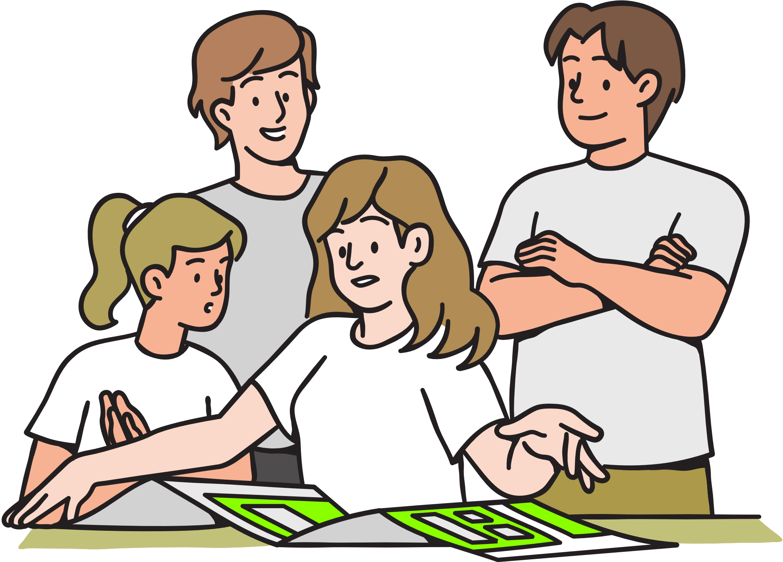

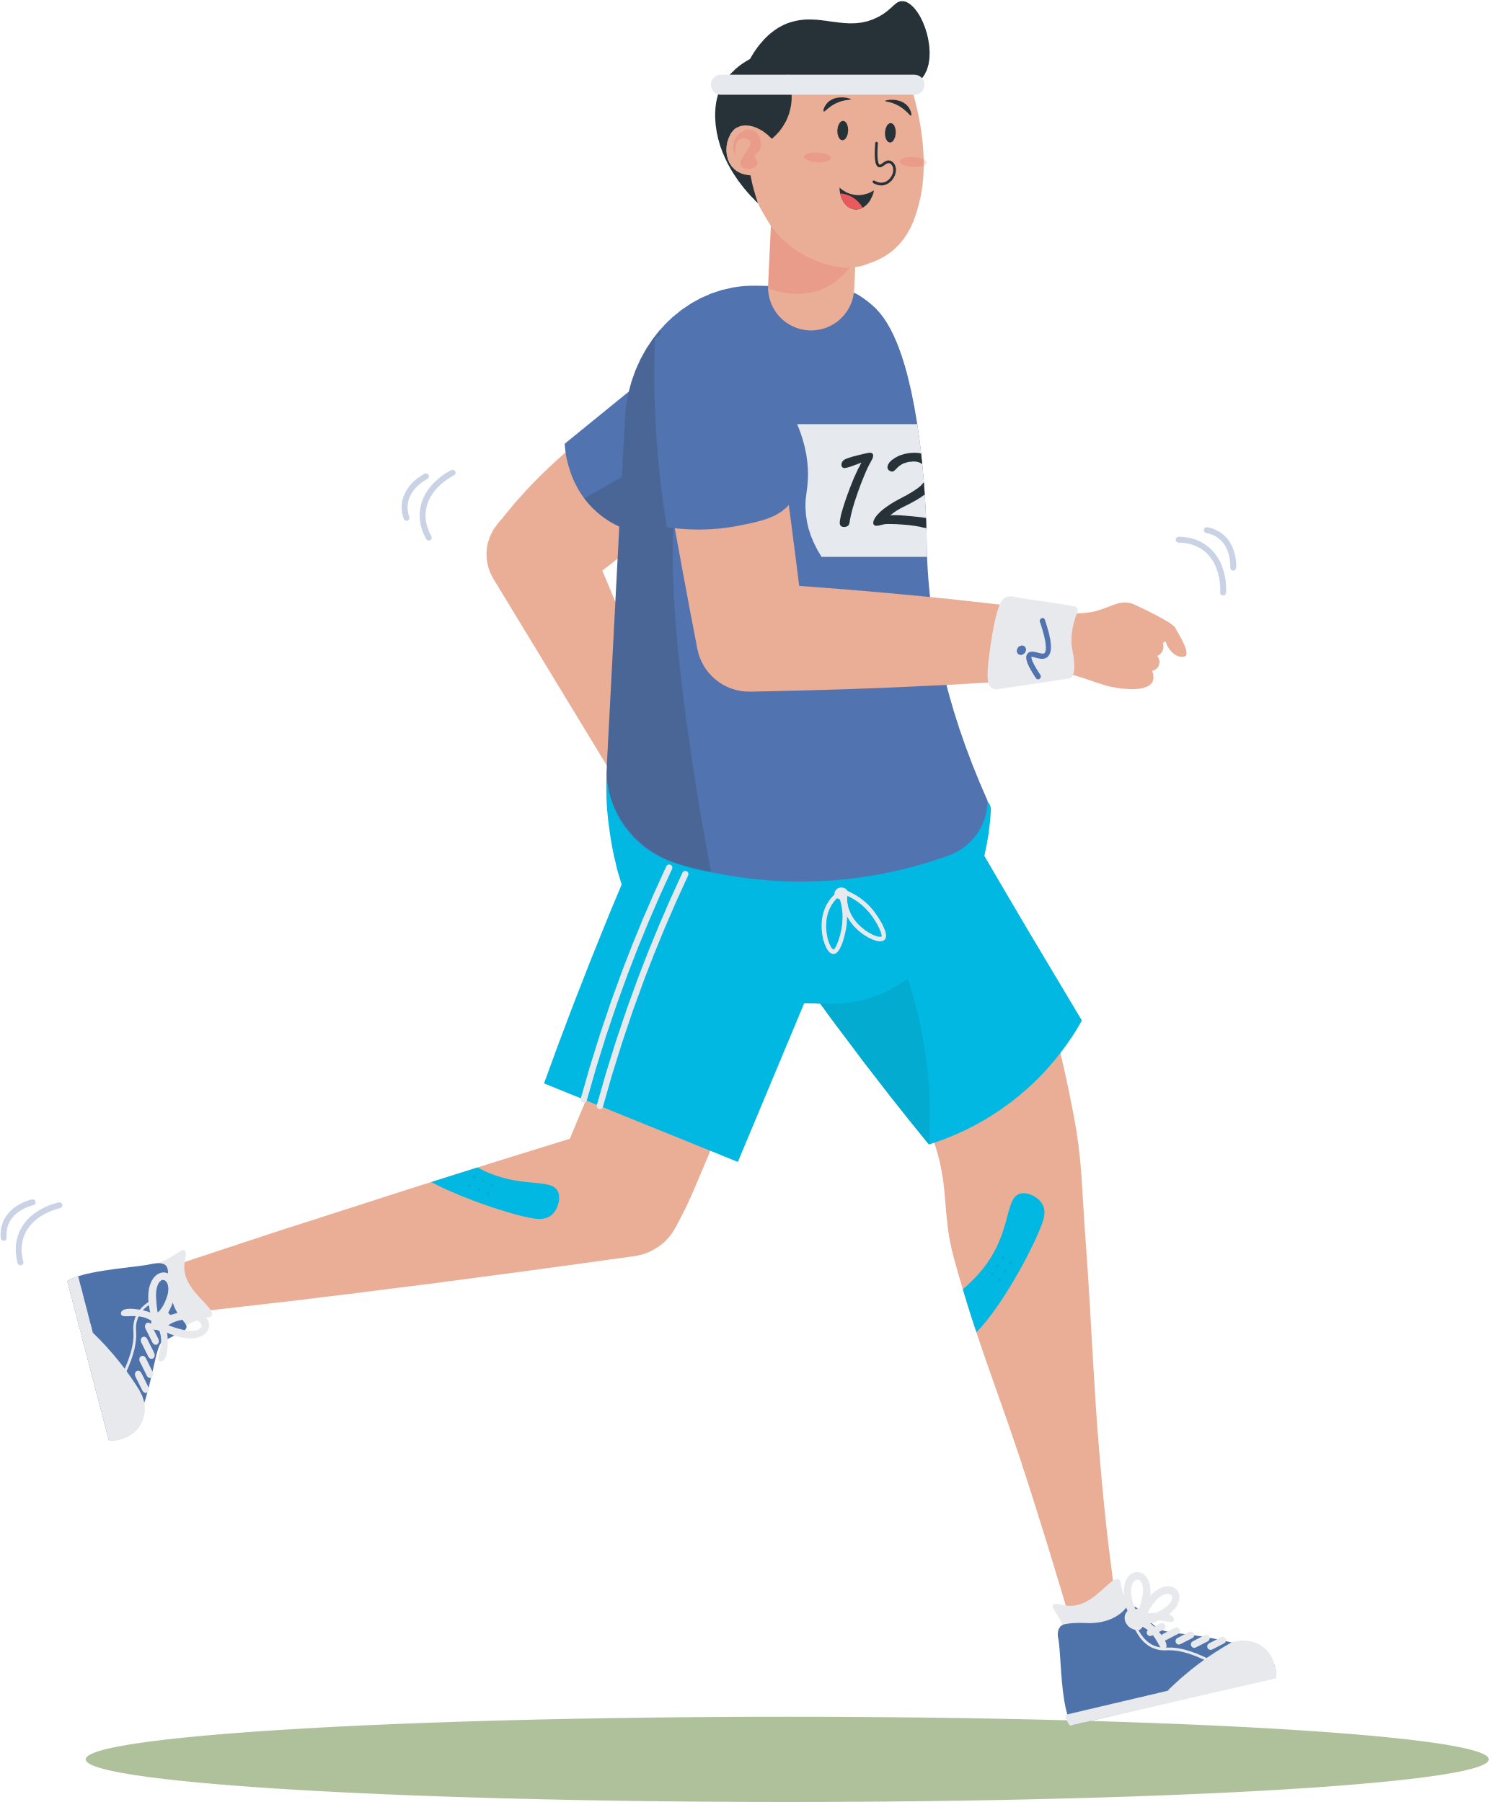

314 participants
mean age range: 61.3 to 70.5
13 Devices
8 manufacturers
5 Physical activity (PA) metrics
Step, time in intensity, Energy Expenditure, time in Physical activity types & walking characteristics)
Devices per Measurement properties
Validity (criterion & construct) n = 11
Test-retest reliability n= 5
Measurement error n = 4 (not rated)
Responsiveness n = 3

Slide 9
Fitbit Charge
Fitbit Charge 2
Fitbit Alta
Fitbit Flex 2
Apple series 4 watch
Actigraph Gt3x+(w)
Actigraph GT3x
SenseWear Armband Pro3
ActiGraph GT1M
SENS Motion plus
OPAL APDM
IMeasureU Blue Trident
Jiakang Zhongzhi Technology
Step count
Energy expenditure
Time in PA intensity
Step count
Time in PA types
Energy expenditure
Time in PA intensity
Step count
Time in PA types
Gait Characteristics
Energy expenditure
Time in PA intensity
Step count
Time in PA types
Gait Characteristics
Energy expenditure
Time in PA intensity
Step count
Time in PA types
Gait Characteristics
Energy expenditure
Time in PA intensity
Step count
Time in PA types
Gait Characteristics
Energy expenditure
Time in PA intensity
Step count
Time in PA types
Gait Characteristics
Energy expenditure
Time in PA intensity
Step count
Time in PA types
Gait Characteristics
Energy expenditure
Time in PA intensity
Step count
Time in PA types
Gait Characteristics
Energy expenditure
Time in PA intensity
Step count
Time in PA types
Gait Characteristics
Energy expenditure
Time in PA intensity
Step count
Time in PA types
Gait Characteristics
Energy expenditure
Time in PA intensity
Step count
Time in PA types
Gait Characteristics
Energy expenditure
Time in PA intensity
Step count
Time in PA types
Gait Characteristics
Energy expenditure
Time in PA intensity
Time in PA types
Gait Characteristics
Gait Characteristics
Test retest Reliability
Criterion Validity
Construct Validity
There are lots of greys!
Responsiveness
Measurement error
High/Mod Sufficient
Low/VeryLow Sufficient
High/Mod Insufficient
Low/ VeryLow Insufficient
Not rated /could not be determined due to lack of sufficient information
Not reported

Slide 10
Fitbit Charge
Fitbit Charge 2
Fitbit Alta
Fitbit Flex 2
Apple series 4 watch
Actigraph Gt3x+(w)
Actigraph GT3x
SenseWear Armband Pro3
ActiGraph GT1M
SENS Motion plus
OPAL APDM
IMeasureU Blue Trident
Jiakang Zhongzhi Technology
Step count
Energy expenditure
Time in PA intensity
Step count
Time in PA types
Energy expenditure
Time in PA intensity
Step count
Time in PA types
Gait Characteristics
Energy expenditure
Time in PA intensity
Step count
Time in PA types
Gait Characteristics
Energy expenditure
Time in PA intensity
Step count
Time in PA types
Gait Characteristics
Energy expenditure
Time in PA intensity
Step count
Time in PA types
Gait Characteristics
Energy expenditure
Time in PA intensity
Step count
Time in PA types
Gait Characteristics
Energy expenditure
Time in PA intensity
Step count
Time in PA types
Gait Characteristics
Energy expenditure
Time in PA intensity
Step count
Time in PA types
Gait Characteristics
Energy expenditure
Time in PA intensity
Step count
Time in PA types
Gait Characteristics
Energy expenditure
Time in PA intensity
Step count
Time in PA types
Gait Characteristics
Energy expenditure
Time in PA intensity
Step count
Time in PA types
Gait Characteristics
Energy expenditure
Time in PA intensity
Step count
Time in PA types
Gait Characteristics
Energy expenditure
Time in PA intensity
Time in PA types
Gait Characteristics
Gait Characteristics
Test retest Reliability
Criterion Validity
Construct Validity
Responsiveness
Measurement error
High/Mod Sufficient
Some evidence exists that could help when choosing a device
Low/VeryLow Sufficient
High/Mod Insufficient
Low/ VeryLow Insufficient
Not rated /could not be determined due to lack of sufficient information
Not reported

Slide 11
Fitbit Charge
Fitbit Charge 2
Fitbit Alta
Fitbit Flex 2
Apple series 4 watch
Actigraph Gt3x+(w)
Actigraph GT3x
SenseWear Armband Pro3
ActiGraph GT1M
SENS Motion plus
OPAL APDM
IMeasureU Blue Trident
Jiakang Zhongzhi Technology
Step count
Energy expenditure
Time in PA intensity
Step count
Time in PA types
Energy expenditure
Time in PA intensity
Step count
Time in PA types
Gait Characteristics
Energy expenditure
Time in PA intensity
Step count
Time in PA types
Gait Characteristics
Energy expenditure
Time in PA intensity
Step count
Time in PA types
Gait Characteristics
Energy expenditure
Time in PA intensity
Step count
Time in PA types
Gait Characteristics
Energy expenditure
Time in PA intensity
Step count
Time in PA types
Gait Characteristics
Energy expenditure
Time in PA intensity
Step count
Time in PA types
Gait Characteristics
Energy expenditure
Time in PA intensity
Step count
Time in PA types
Gait Characteristics
Energy expenditure
Time in PA intensity
Step count
Time in PA types
Gait Characteristics
Energy expenditure
Time in PA intensity
Step count
Time in PA types
Gait Characteristics
Energy expenditure
Time in PA intensity
Step count
Time in PA types
Gait Characteristics
Energy expenditure
Time in PA intensity
Step count
Time in PA types
Gait Characteristics
Energy expenditure
Time in PA intensity
Time in PA types
Gait Characteristics
Gait Characteristics
Test retest Reliability
Criterion Validity
Construct Validity
Responsiveness
Measurement error
No high level evidence to show any device is insufficient
High/Mod Sufficient
Low/VeryLow Sufficient
High/Mod Insufficient
Low/ VeryLow Insufficient
Not rated /could not be determined due to lack of sufficient information
Not reported

Slide 12
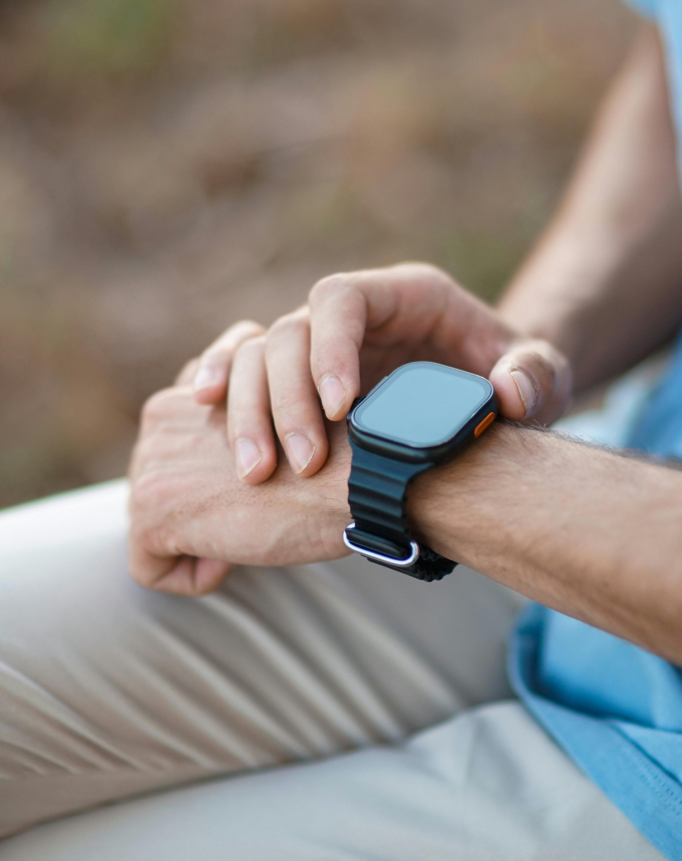
Acknowledgements
Prof. William G. Dixon (1)
A/Prof Steph Filbay (2)
Prof. Fiona Dobson (2)
Prof Kim Bennell (2)
Dr. Emily Cross (3)
Sam Kayll (2)
Affiliations
1. Centre for Health Informatics, University of Manchester
2. Centre for Health, Exercise & Sport Medicine (CHESM), University of Melbourne
3. Virtual Fracture Department, Royal Melbourne Hospital
Thank you for listening!
Contact Details
Photos
Ayobami E. Olanrewaju (PhD Candidate)
freepik.com
Canva
Email: ayobami.olanrewaju@postgrad.manchester.ac.uk
Linkedin: https://www.linkedin.com/in/olanrewaju-ayobami/

